Slide 1
Granular Materials
Cary Academy (Ben Humphries and ross matton)

Slide 2
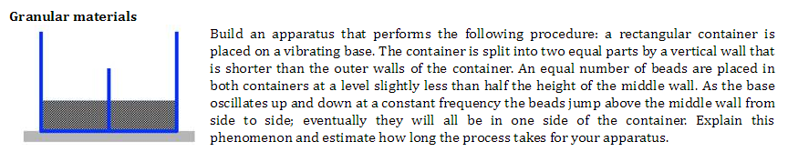
Initial Hypothesis
- Ball to ball collisions dissipated energy; the more collisions, the less energy.
- As one side gained more balls, that side‘s balls had less opportunity to jump the partition.
- This effect snowballs as time goes on and more balls favor one side.

Slide 3
Physical Apparatus Materials and Tools
- Plexiglass sheet
- Epoxy resin
- Polyurethane 6 mm BBs
- Pasco Wave Generator
- Vernier Power Amplifier (program)
- Lego piece
- Dremel
- Rubber band

Slide 4
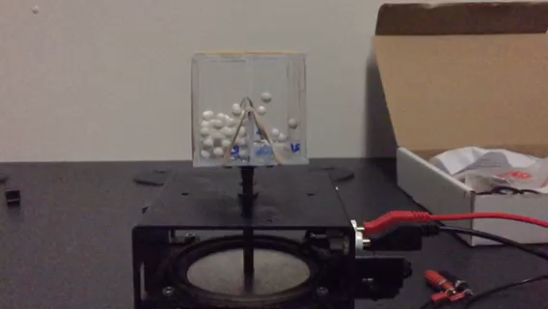
Physical Apparatus
- How it works
Small plexiglass box attached to a speaker. High voltage sounds were played which bounced the speaker up and down, oscillating the box. (speaker frequency was locked at 25 Hz)
- Independent variables
Frequency
Waveform
Voltage
Number of balls
- Sources of error
Off-center box
Imperfect cut box
Single ball case

Slide 5
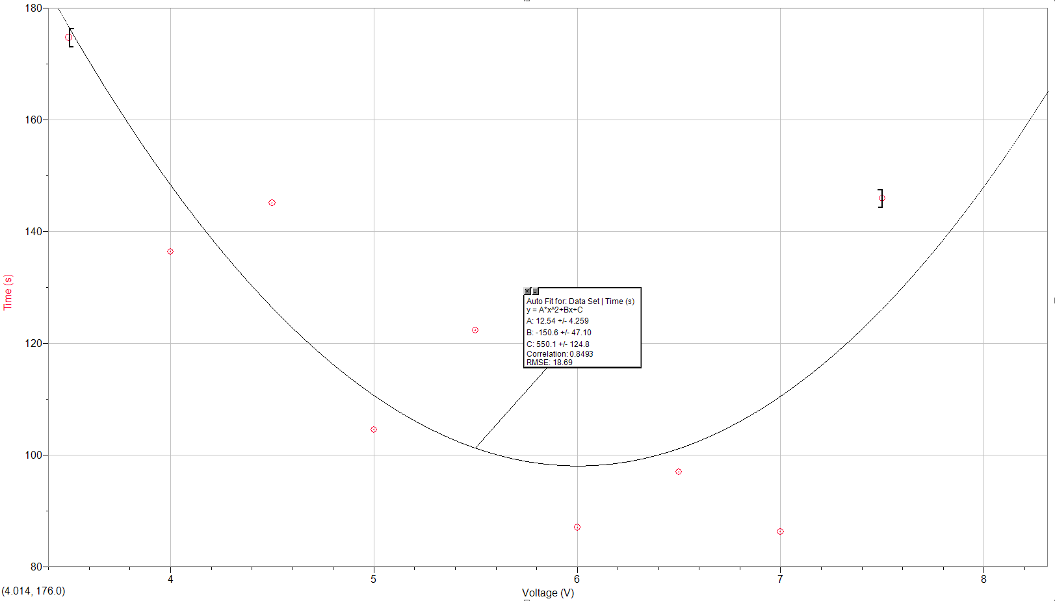
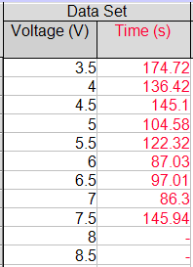
Apparatus Results
At the global minimum, the phenomenon should take
~ 98.1 seconds

Slide 6
Observations and Conclusions
- Side preference develops quickly
- At the lower voltages the preference doesn’t switch (snowballs until complete)
- At higher voltages the side preference would intermittently switch due to increase in ball movement
- Above 8 volts, there was rapidly shifting bias

Slide 7
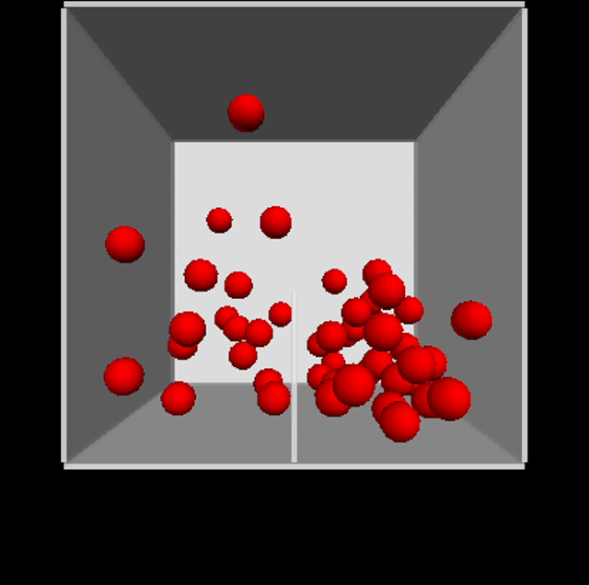
VPython Simulation
- Independent variables
Coefficient of restitution of ball to ball collisions
Ball radius
Number of balls
Box size
- Sources of error
No physical box movement, just velocity added from the floor
Elastic collisions between the walls and the balls
Single ball case (impractically high speeds of the last ball on one side)
Abstract energy values

Slide 8
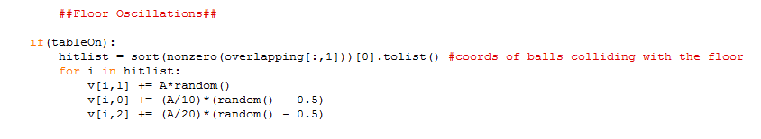
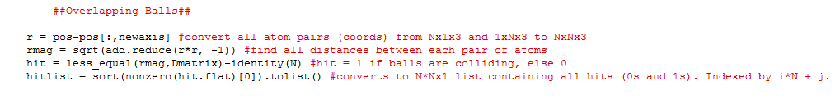
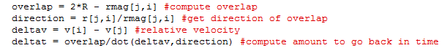
Code Snippets

Slide 9
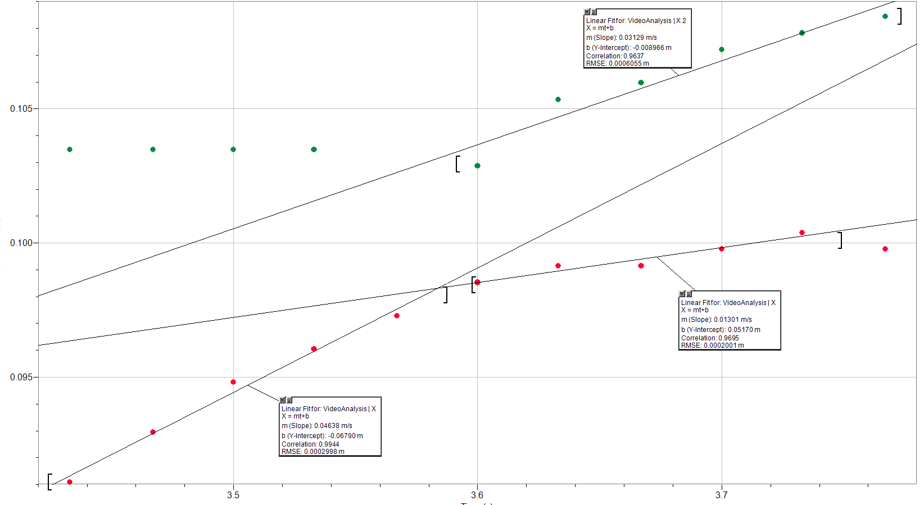
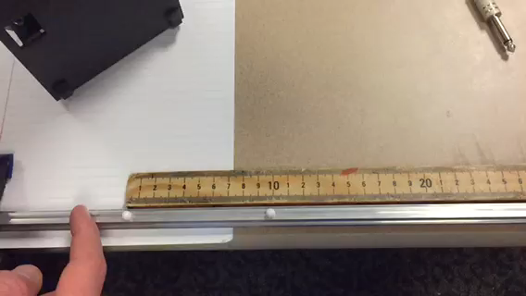
Calculating Coefficient of Restitution
- Used video analysis to determine coefficient of restitution between balls
- Result averaged to about .47 (error from friction, imperfect video analysis)

Slide 10
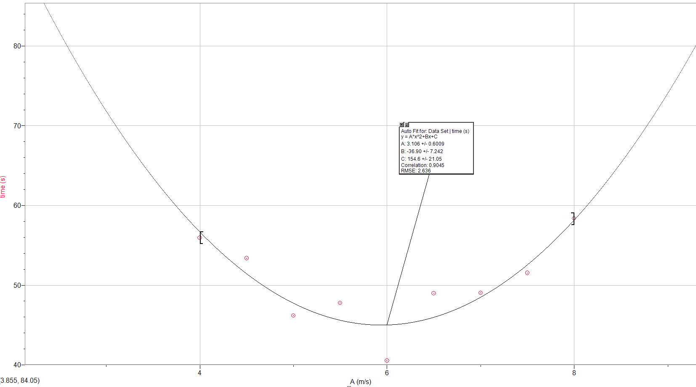
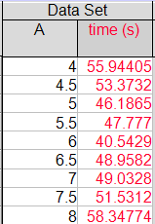
Simulation Results

Slide 11
Observations and Conclusions
A = 1-3: Insufficient energy.
A = 4-6: Gradually move from one side to the other, usually one at a time.
A = 7-10: Preferred side can switch; much more overall movement, balls hit the top.
A = 11-15: Multiple balls switching sides per second, grouped balls are disseminated more often.
A = 16: Chaos with little grouping.
Optimal point is a medium between having sufficient energy to cross the partition and to be contained by ball to ball collisions that expel energy.

Slide 12
Curve Comparison *scaled to be proportionate
Simulation
Physical Apparatus

Slide 13
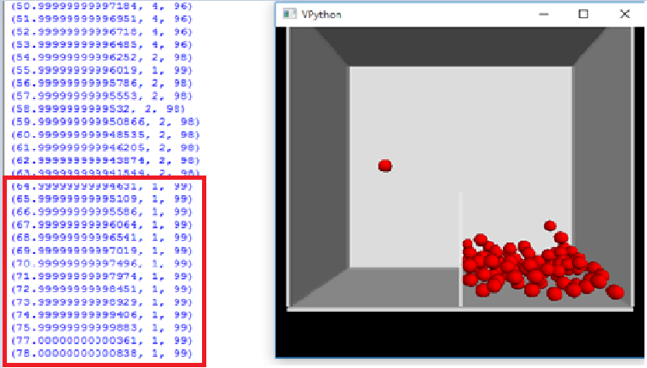
Single Ball Case
- One ball with a high magnitude vertical velocity and minimal horizontal velocity
- Prevents the completion of a simulation/physical test by perpetually bouncing up and down
- Occurs in both the python simulation and the physical apparatus
- Lack of ball collisions causes less change in horizontal movement
- Avoided by stopping the time when the single ball case occurred.

Slide 14
Understanding the Problem
Hypothesis
- Collisions between balls
- Energy dissipation
- Snowball effect
Conclusion
- Similar curve shapes
- Correlation between simulation and physical apparatus

Slide 15
Documents/Files

